Slide 1

ESD - Ticket Auto-Assignment TF-IDF Keyword Analytics Model
PTEMS RPA TEAM

Slide 2

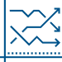

Speaker Intro
Current Position – Senior Consulting Analyst, Intelligent Automation
Education - B.S. Mechanical Engineering, North Carolina State University | Currently pursuing M.S. Computational Data Analytics, Georgia Tech
Some Recent Analytics Projects:
Atlanta Property Value Clustering & Regression Classification Tool
Elevated Blood Pressure Prediction Tool on General US Population
Niko Lahanis

Slide 3

Meeting Outline
Model Inspiration
Model Overview
TF-IDF Methodology
Applications to Existing Automation
Model Considerations
Moving Forward

Slide 4
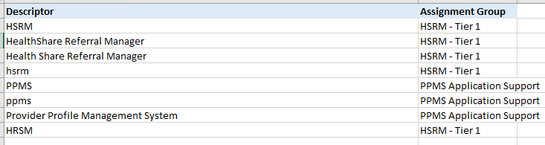


Model Inspiration
“What can we as an RPA team do to increase the number of tickets this automation properly captures?”
Sparse Mapping Tables
Previous Automation Inaccuracy

Slide 5
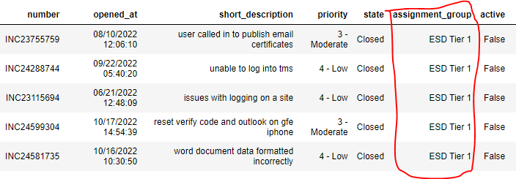
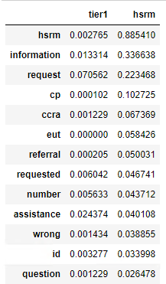
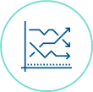
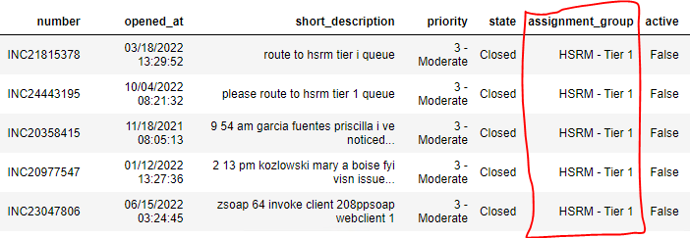
Model Overview
Input Data Source A
TF-IDF Scoring Algorithm
Model Output
Input Data Source B
* The model in this presentation compares two sets of data between each other: closed ‘ESD Tier 1’ Tickets and closed ‘HSRM – Tier 1’ Tickets.

Slide 6
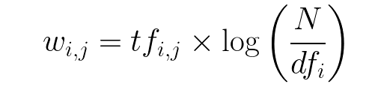
TF-IDF Scoring System
Term Frequency (TF)
Inverse Document Frequency (IDF)
The total number of times a specific term appears in a given data frame
*An increase in term frequency for a data frame leads to an increase in TF-IDF scores.
-The TF term represents a “reward”. If a term shows up often within a given dataset, we want it to be rewarded for being more common.
The total number of data frames, divided by the total number of data frames that contain a specific term
*An increase in inverse document frequency corresponds to a decrease in TF-IDF scores
-The IDF term represents a “penalty”. If a term is common among more than one dataset, the term may not be useful in identifying difference between the datasets

Slide 7


Applications
How can we apply this to the existing automation in development?
Identify additional keywords that have an outsized TF-IDF score for Hardware Incidents and PPMS/HRMS Requests.
By finding more relevant keywords associated with each of these mapping tables, we can increase overall automation performance.

Slide 8

Model Considerations
Some model tuning parameters we can potentially discuss further
Would you want this model to incorporate two and three word phases (bigrams and trigrams), not just single word terms?
What cutoff threshold/key term number limit would you like to incorporate into this model? (i.e. only terms with a TF-IDF score above .3)
Are Closed, ‘ESD Tier 1’ tickets the proper dataset to use as our general population when creating this analysis?

Slide 9



Moving Forward
Scalability – this model can easily be built out to identify key terms for additional mappings (if this automation increases in scope).
Iterable – this model has the potential to be ran on a scheduled basis, in-line with the current automation by using updated data at scheduled intervals. (currently out-of-scope of the existing timeline)
RPA to IA – the incorporation of this model into an existing VA automation lays the groundwork for Robotic Process Automation projects to move closer to Intelligent Decision- Making

